Slide 1
Predictive Maintenance for Automatic Production Systems
CSE 495
Preliminary Presentation
Abdurrahman BULUT
Supervisor: Pr. Dr. İbrahim SOĞUKPINAR
April 2023
Notes:
Hi, My name is Abdurrahman. Today, I'll talk to you about my presentation on Predictive Maintenance for Automatic Production Systems.

Slide 2
Content
Project Definition
Related Works
Project Design Plan
Project Requirements
Project Timeline
Success Criterias
Resources
Notes:
The presentation content is as follows; …..

Slide 3
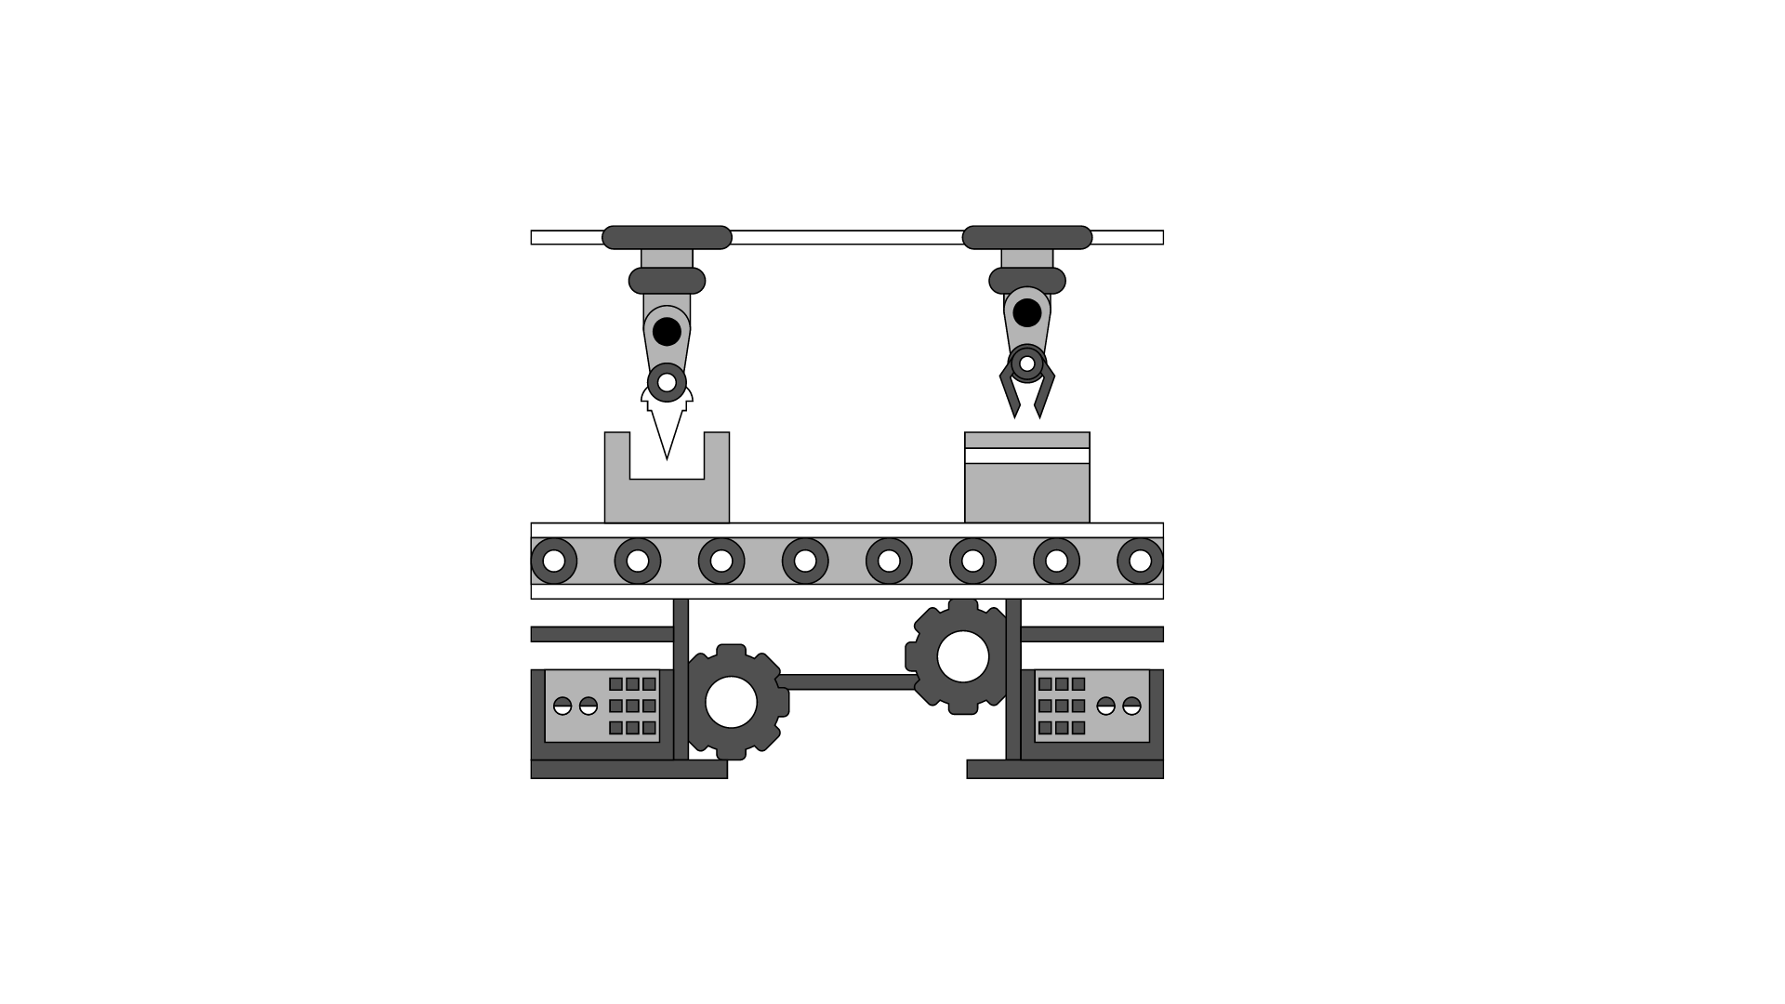
Project Definition
What is the project about?
Automated production systems are manufacturing systems that use automated equipment, such as robotics, sensors, and computer-controlled machinery, to perform production processes.
If the problems that may arise in these machines are not detected early, problems may arise in terms of both financial and time.
The system will collect and analyze data from sensors installed on the manufacturing equipment, including vibration, pressure, voltage, temperature, and other relevant data points. It will use this data to create a predictive model that can identify patterns and anomalies in the equipment's behavior that may indicate potential faults.
Keyword: Predictive Maintenance
Notes:
What is the project about?
The fourth industrial revolution has led to increasingly complex and automated production systems, which require a proactive maintenance approach to ensure optimal performance.
What is the Automated production systems?
They are manufacturing systems that use automated equipment, such as robotics, sensors, and computer-controlled machinery, to perform production processes.
The keyword for this project is Predictive maintenance.It means that it uses data analytics to identify potential equipment failures before they occur. it is a key strategy for reducing downtime, increasing efficiency, and improving overall equipment effectiveness. This project aims to implement a predictive maintenance program for automatic production systems, with the goal of maximizing productivity and minimizing the risk of costly breakdowns.
The system will collect and analyze data from sensors installed on the manufacturing equipment, including vibration, pressure, voltage, temperature, and other relevant data points.

Slide 4
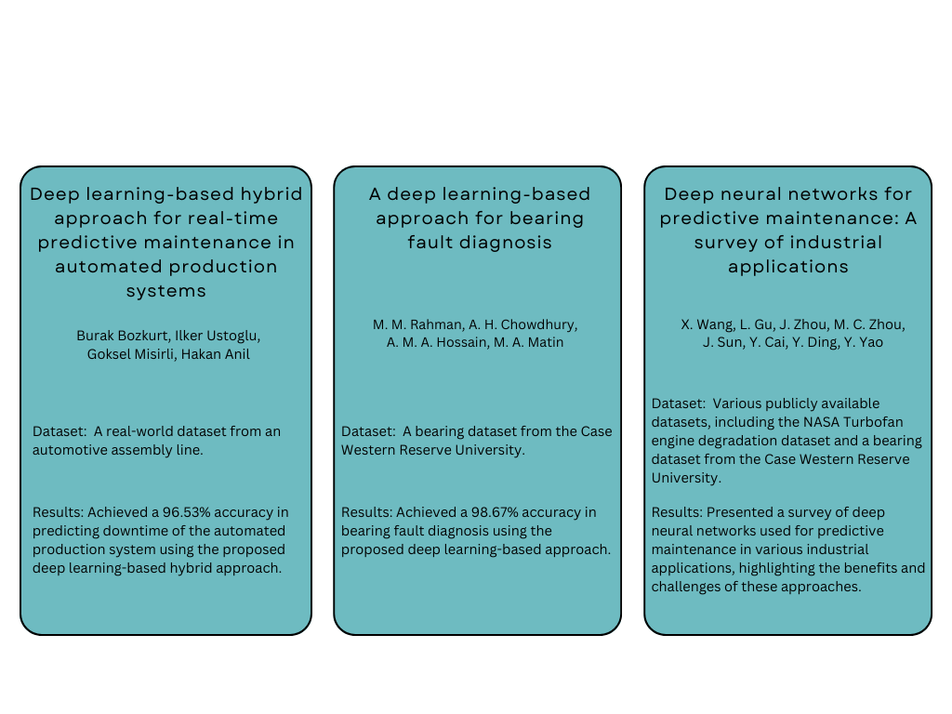
Related Works
According to some studies, early detection provides an advantage of 30% in terms of time and 40% in prolonging the life of the machine.
Notes:
Several studies have shown that implementing predictive maintenance can result in significant improvements in equipment reliability, as well as reductions in maintenance costs and unplanned downtime. I put 3 example works in this area and I will continue to review other works. In addition to the automatic production system, studies were carried out for different types of machines such as Bearing, Turbofan. According to some studies, early detection provides an advantage of 30% in terms of time and 40% in prolonging the life of the machine.

Slide 5
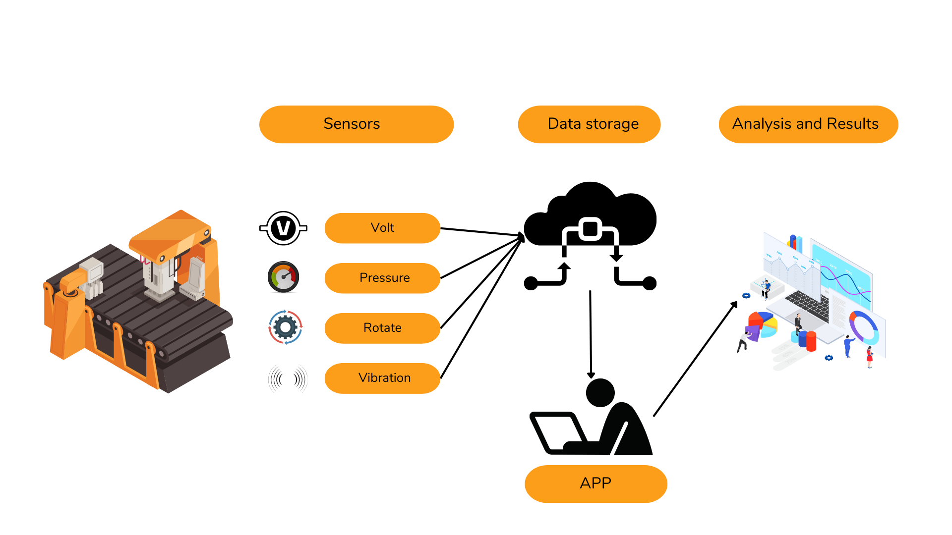
Project Design Plan
Notes:
Project design plan. I will be using some sensors data such as volt, pressure, rotation and vibration. Then it will be stored in a data storage. After that the user will put those data to the program as an excel file. And the user will be see whether a component of the machine needs to repair or not.

Slide 6
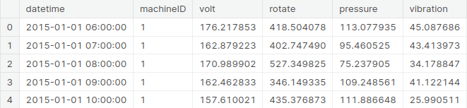
Project Requirements - 1
Finding a comprehensive dataset is very important.
It is necessary to determine the parameters that affect the healthy of the machines. (volt, pressure etc.)
It would be helpful to analyze machine learning algorithms that are frequently used in past research and the algorithms that gives best result.
User should be able to upload events logs to the app via interface.
Sample Data
Notes:
In order to successfully implement this predictive maintenance program, I will need to have access to high-quality sensor data, as well as historical maintenance records. It would be helpful to use some machine learning algorithms that gave best result in the past researches.
The table shows some data from a sample dataset as an example.

Slide 7
Project Requirements - 2
Dataset: Microsoft Azure Predictive Maintenance, Kaggle
The algorithms that I may use are follows:
Newton-Cg
ARIMA
Linear Regression
Gaussian
Poly SVC
Some required technologies and libraries are:
Python
Colab
Numpy
Pandas
Scikit-learn
Matplotlib
Android Studio – Flutter or
React
Notes:
I may use these algorithms and these technologies to analyse the data and create a product.

Slide 8
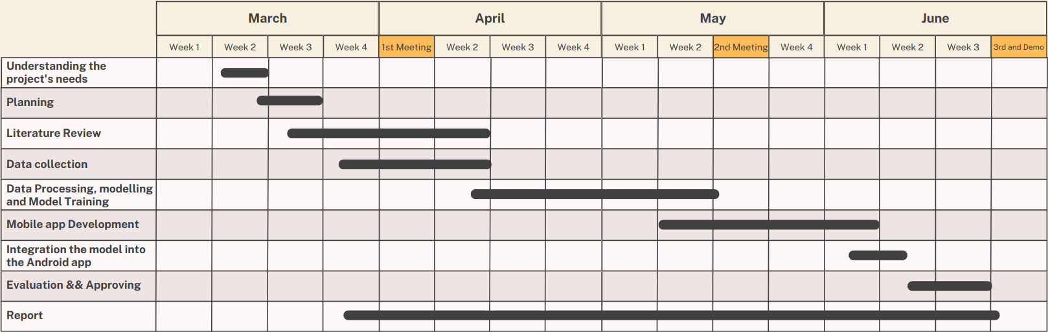
Project Timeline
Notes:
This is the project timeline. I worked on planning and I have been working on Literature Review parts. By the 2nd presentation, I have found the data set, processed the data and modeled it. Then I will start to develop an android app.

Slide 9
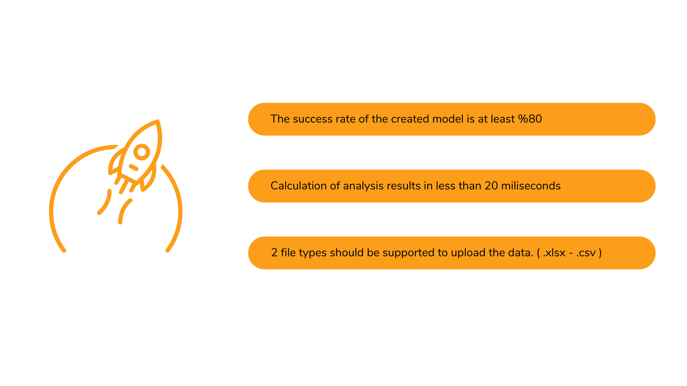
Success Criteria
Notes:
My first success criteria is….
Second is…
Las one is ….

Slide 10
Resources
“Microsoft Azure Predictive Maintenance”, ARNAB, “https://www.kaggle.com/datasets/arnabbiswas1/microsoft-azure-predictive-maintenance”
“A Deep Learning Based Approach for Bearing Fault Diagnosis, “https://www.researchgate.net/publication/313125160_A_Deep_Learning_Based_Approach_for_Bearing_Fault_Diagnosis”
“Artificial intelligence for fault diagnosis of rotating machinery: A review,
“https://www.researchgate.net/publication/326742898_Artificial_intelligence_for_fault_diagnosis_of_rotating_machinery_A_review”
“Fault Handling in Industry 4.0: Definition, Process and Applications”,
“https://www.mdpi.com/1424-8220/22/6/2205”
“An Industry 4.0 Dataset of Contextual Faults in a Smart Factory”,
“https://www.sciencedirect.com/science/article/pii/S1877050921003148?via%3Dihub”
Notes:
And Resources, Thank you..

